Slide 1

INT 300 Internship
Prediction of Chronic kidney Disease using
Machine Learning Algorithm
Second review
Team Members
Sivane senthil( E0121027)
Marreddy Gayatri devi( E0421053)
Project Guide
1. Prof .Shiyamala Gowri

Slide 2
Introduction
Machine learning uses various algorithms for building mathematical models and making predictions using historical data or information.
Machine Learning is the field of study that gives computers the capability to learn without being explicitly programmed.
Currently, it is being used for various tasks such as image recognition, speech recognition, email filtering, Facebook auto-tagging, recommender system, and many more.

Slide 3
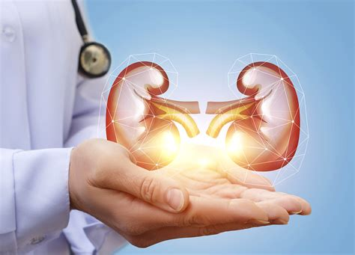
Problem statement
The objective of this project is to check whether the patient is to predict patients with Chronic Kidney Disease using attributes while maintaining a higher accuracy on time.
By using this dataset, we predict whether the patient can have a chronic kidney disease or not. To predict this, we use 25 attributes and 400 rows

Slide 4
Research survey
Datasets | Methodology | Accuracy | Researched by
Chronic kidney disease | Decision tree | 95.92%. | Saurabh Paul
Chronic kidney disease | SVM algorithm | 96.7 % | Siddheshwar Tekale, Pranjal Shingavi
Chronic kidney disease | Logistic regression | 98.8% | Salma Shaji, S R Ajina

Slide 5
Work flow
Data collection
Data pre-processing
Algorithms
Future Reinforcement
Prediction

Slide 6
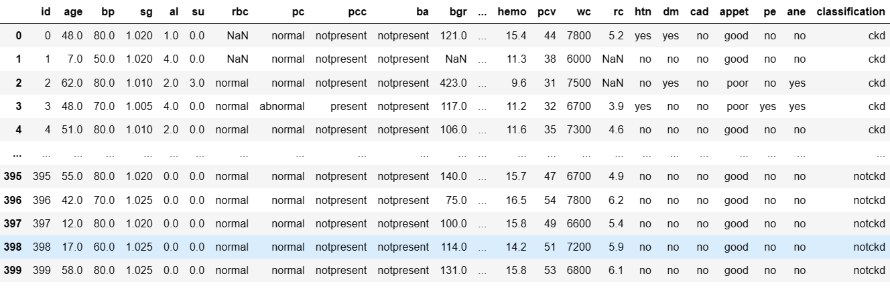
Dataset

Slide 7
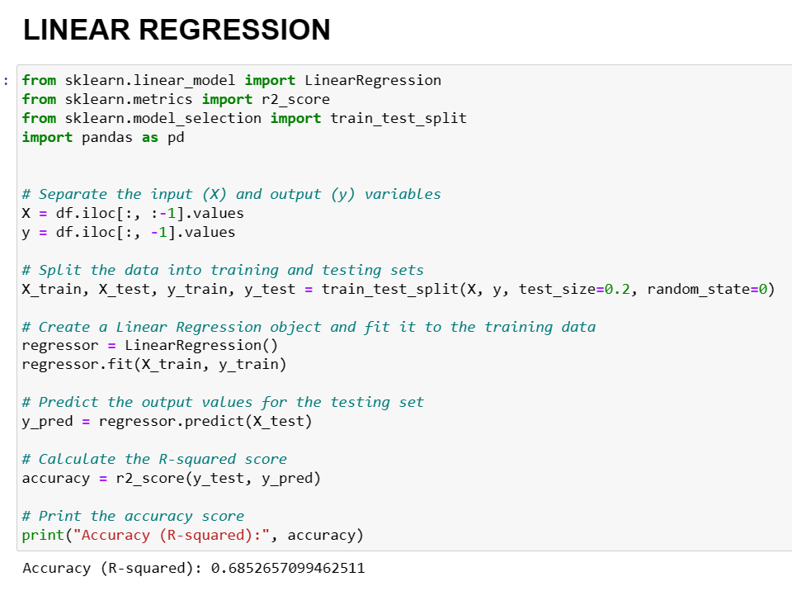
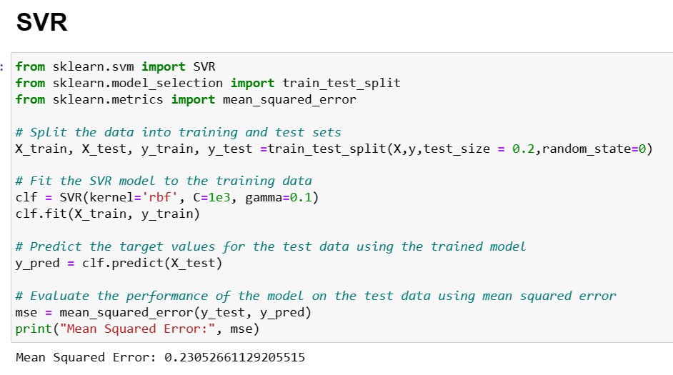
Regression

Slide 8
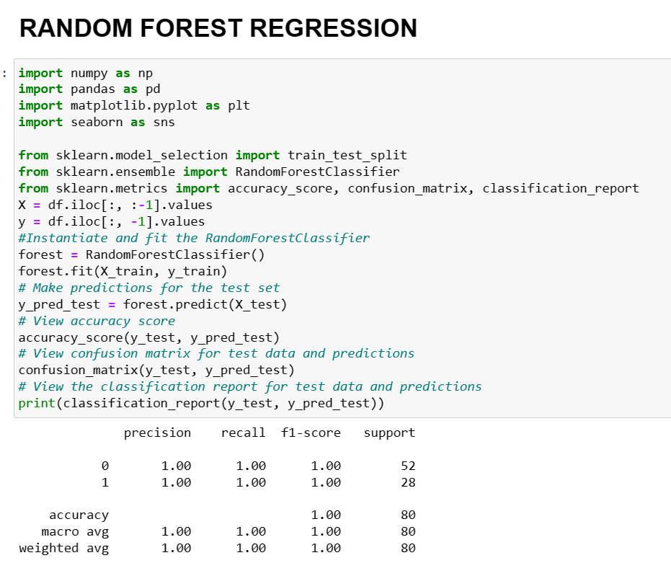
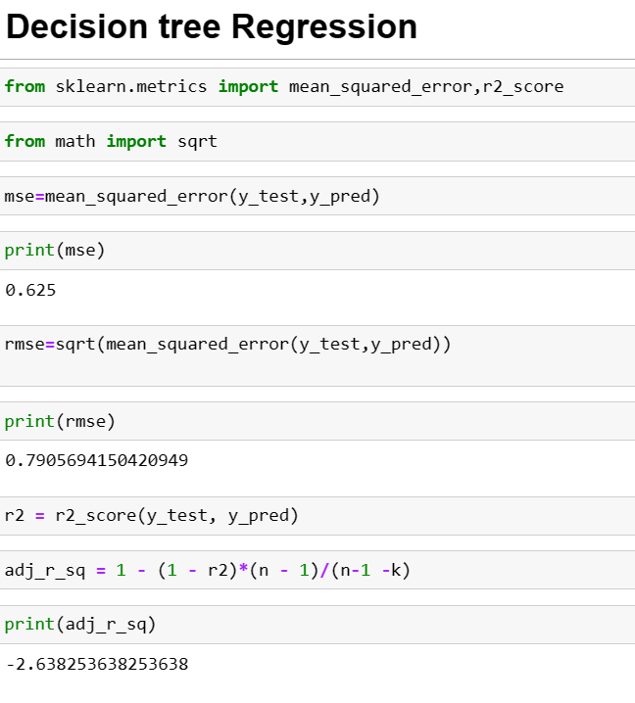
Regression

Slide 9
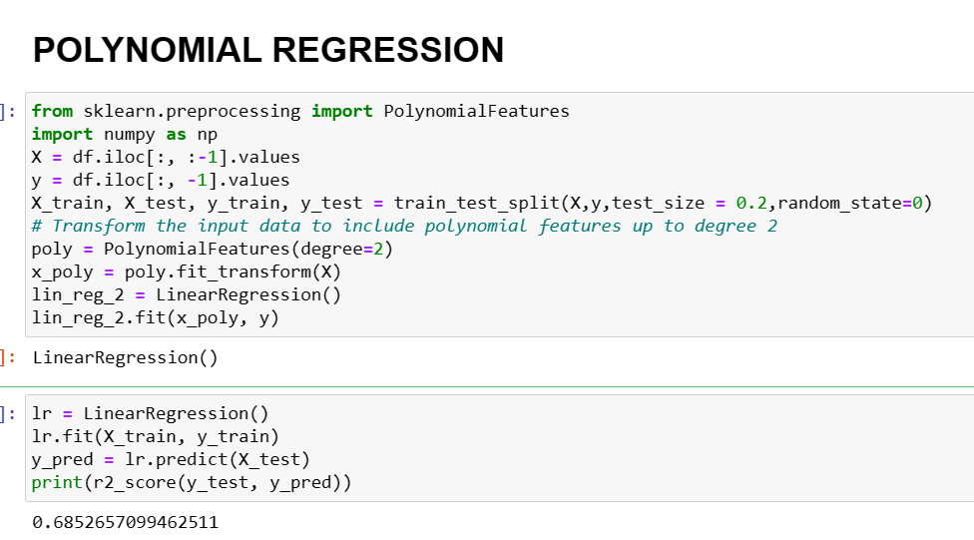
Regression

Slide 10
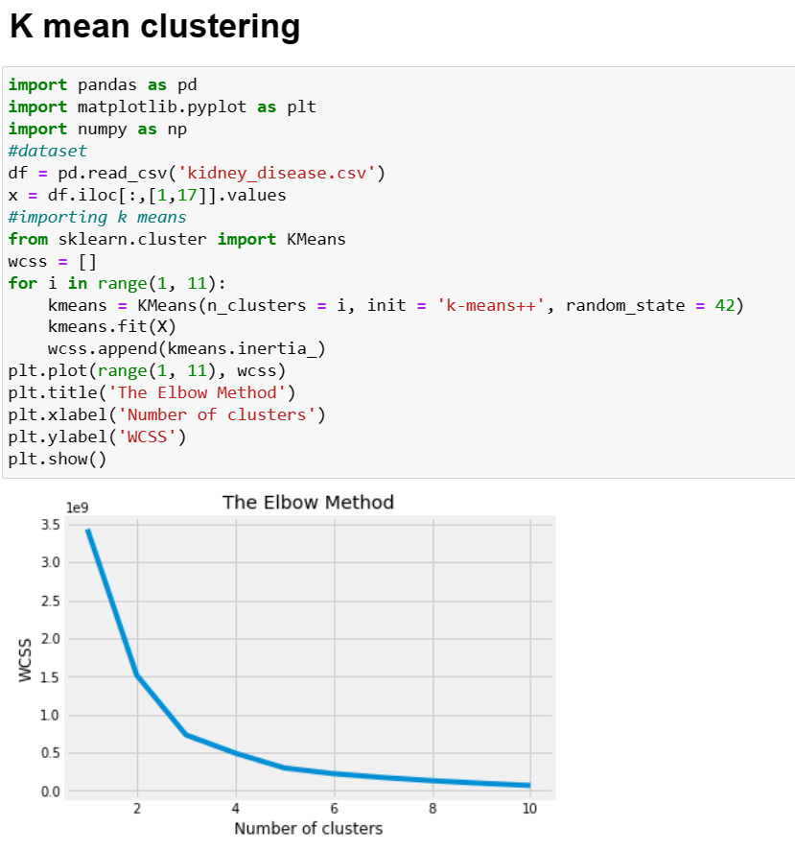
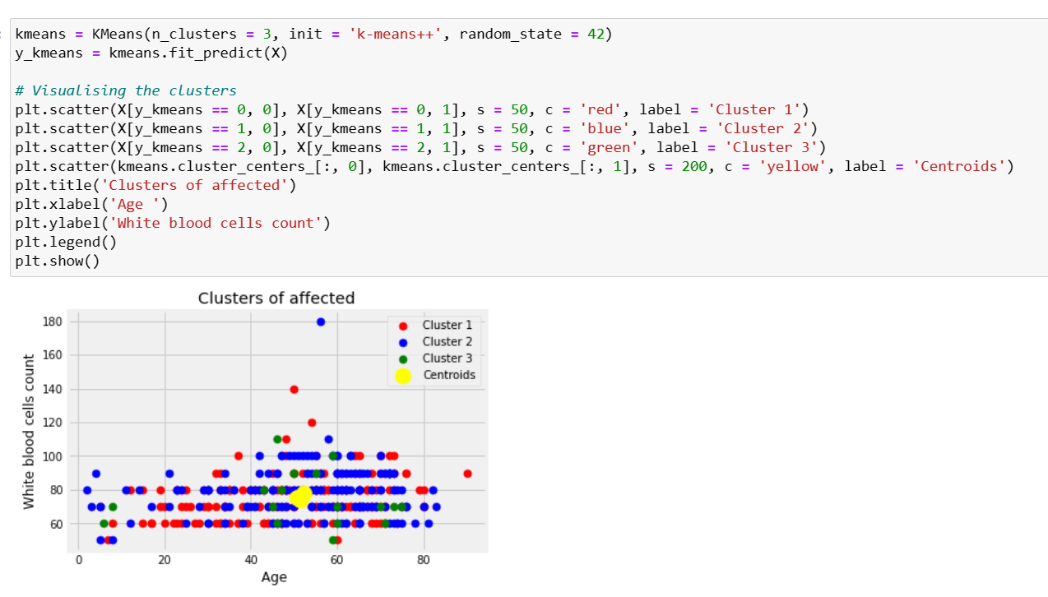
Clustering

Slide 11
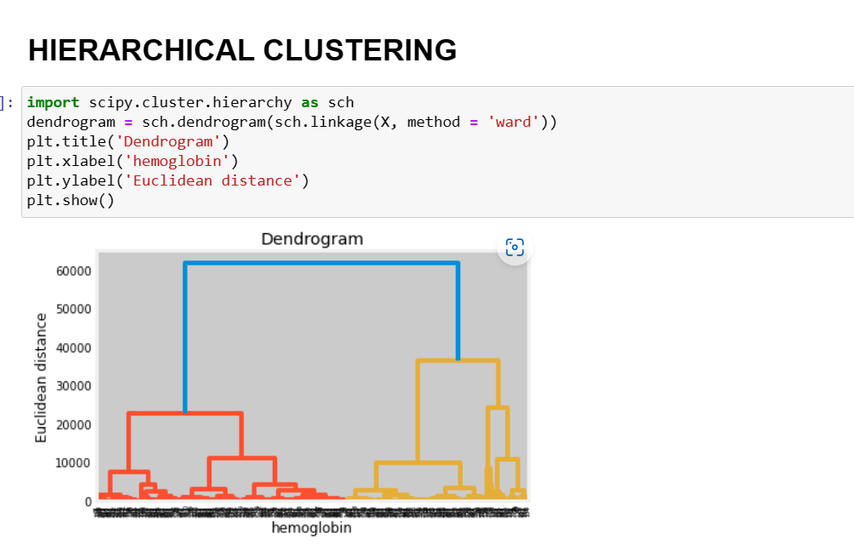
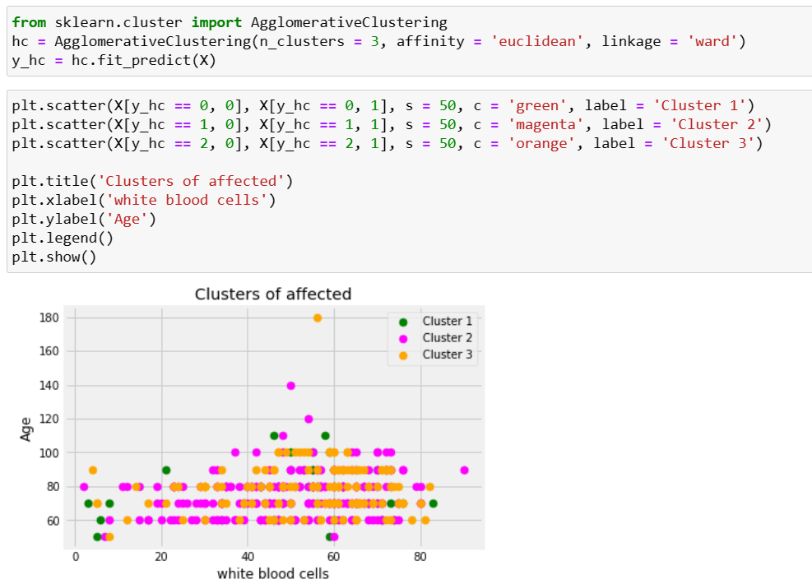
Clustering

Slide 12
Work done
Data collection
Worked on Data Pre processing
Worked on correlation
Converted string values to float
Done Regression (Logistic Regression, Linear Regression, Polynomial Regression, Decision Tree, Random Forest Regression)
Done Classification(KNN, Naive bayes, SVM, Decision Tree, Random Forest)
Done Clustering (K Mean, Hierarchical).
Conclude the model

Slide 13
Timeline of the work
First date | Last date | Work done
20-02-2023 | 01-03-2023 | Learnt Machine Learning from Udemy videos and practiced
02-03-2023 | 06-03-2023 | Got the ckd dataset and started working on Data preprocessing
07-03-2023 | 16-03-2023 | Worked on classification
18-03-2023 | 27-03-2023 | Worked on types of classification
28-03-2023 | 08-04-2023 | Worked on regression
09-04-2023 | 12-04-2023 | Worked on types of regression
13-04-2023 | 12-04-2023 | Worked on Clustering

Slide 14
Conclusion
In clustering, k-mean clustering is the best compared to hierarchical cluster
In Regression Random forest regression has the highest accuracy

Slide 15
Reference
https://journalofbigdata.springeropen.com/articles/10.1186/s40537-022-00657-5
https://link.springer.com/article/10.1007/s44174-022-00027-y
https://rn-journal.com/journal-of-nursing/innovation-for-chronic-kidney-disease

Slide 16
Thank you

